Slide 1
Medical Biology – Year 1
Lab 3: Using of the light microscope
By Lecturer: Dr. Hanaa Ali Hussein
Department: Basic Sciences
College of Dentistry
University of Basrah
University of Basrah – College of Dentistry– Basic Sciences

Slide 2
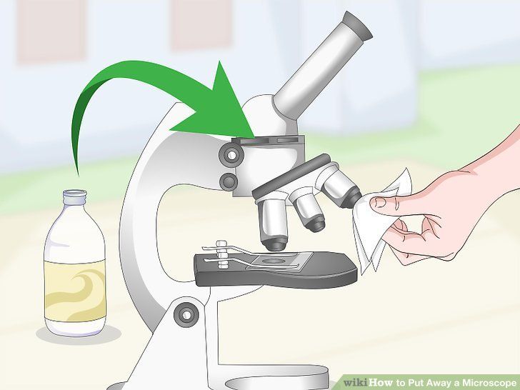
1- Take the cover off and place the microscope on a convenient position.
Using of the light microscope:-
2- Clean the objective and the ocular lens, using special lens paper.
University of Basrah – College of Dentistry– Basic Sciences
2

Slide 3
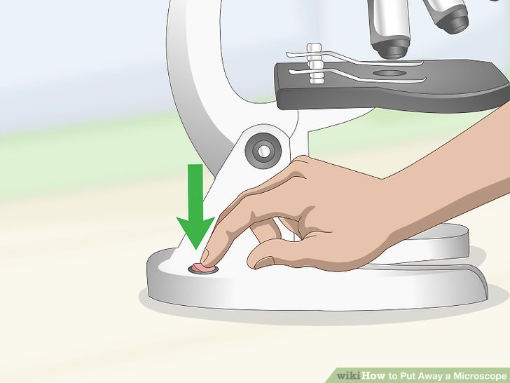
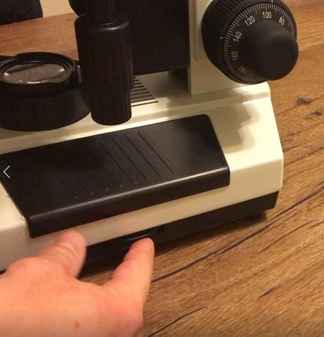
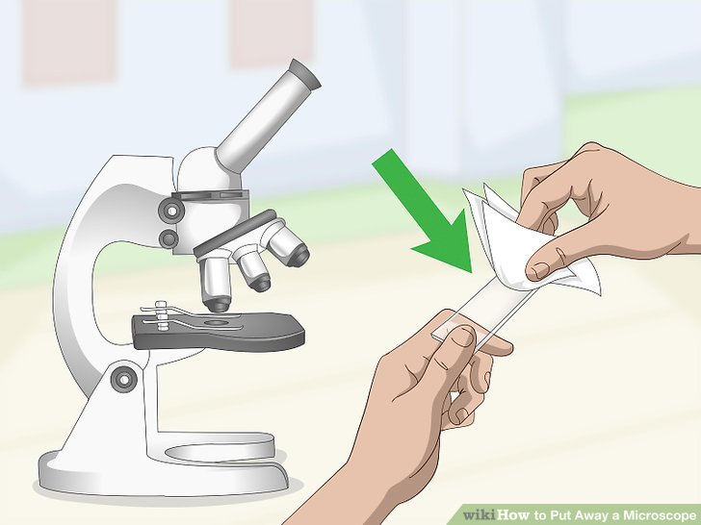
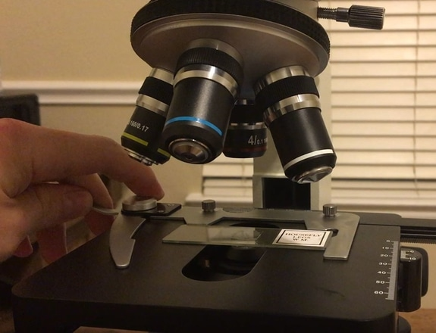
3- Switch on the lamp at low intensity, then increased it gradually.
Using of the light microscope:-
4- Clean the glass slide (specimen) and place it on the mechanical stage, fix it using mechanical stage clips.
University of Basrah – College of Dentistry– Basic Sciences
3

Slide 4
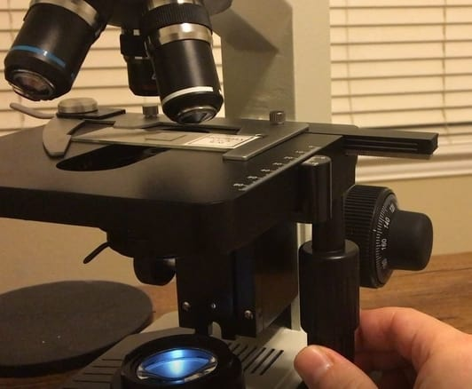
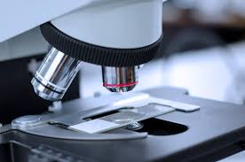
5- Move the slide using the mechanical stage adjustment knobs in the X and Y directions to bring the specimen to the center of the field.
Using of the light microscope:-
adjustment knobs
6- Always start with smallest scanner objective lens (4x).
(4x) lens
University of Basrah – College of Dentistry– Basic Sciences
4

Slide 5
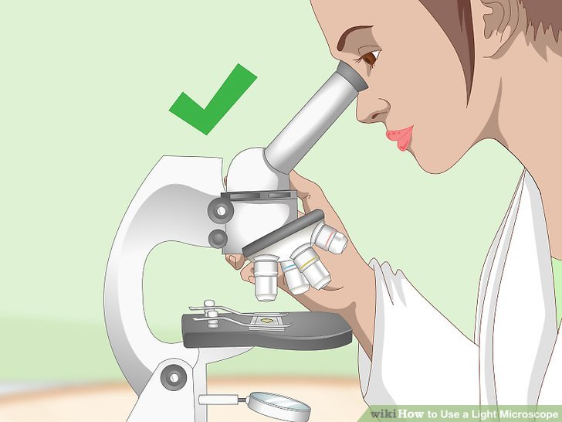
7- Raise the stage with coarse focus knob until you get a clear image.
Using of the light microscope:-
coarse focus
8- Look through the ocular lens and define the area to be examined.
University of Basrah – College of Dentistry– Basic Sciences
5

Slide 6
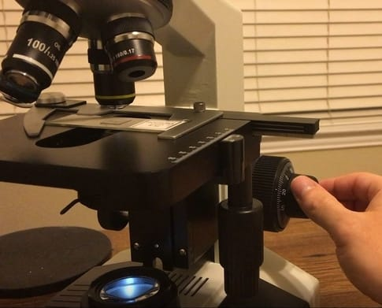
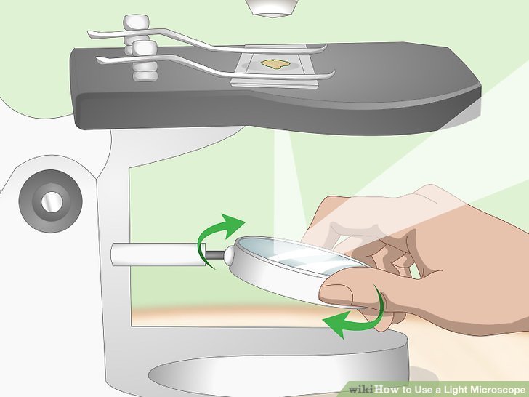
9- Use the low power objective lens (10x) to enlarge the image, refocus using the coarse adjustment knob.
Using of the light microscope:-
(10x)
coarse
10- Adjust the light as needed and readjustment the focus using the fine focus adjustment knob.
University of Basrah – College of Dentistry– Basic Sciences
6

Slide 7
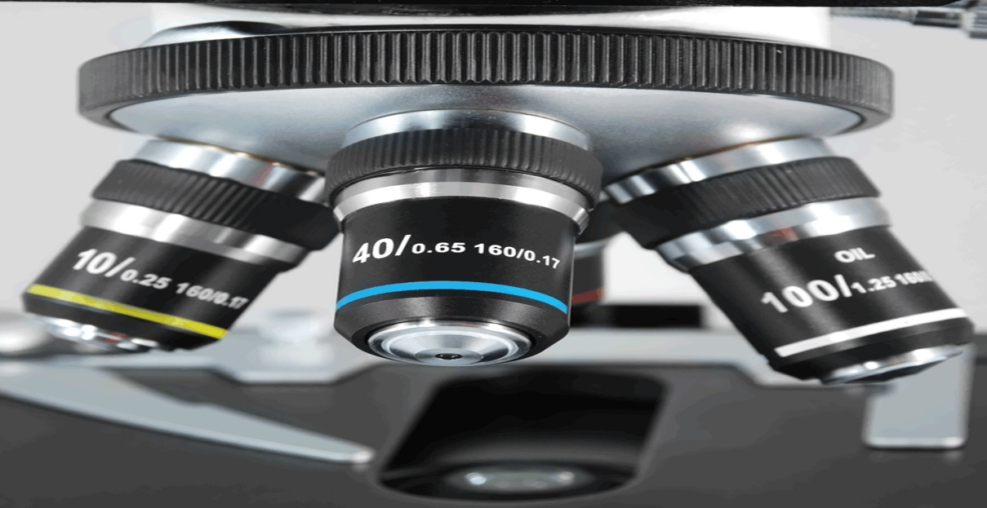
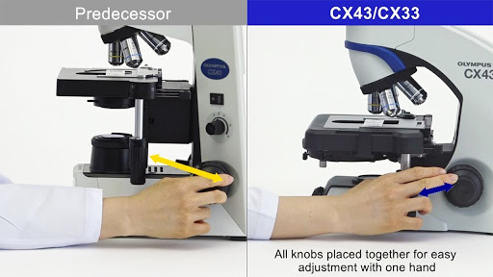
11- Use the high power objective lens (40x) to define required details.
Using of the light microscope:-
12- Readjust the light and refocus the fine adjustment knobs only.
University of Basrah – College of Dentistry– Basic Sciences
7

Slide 8
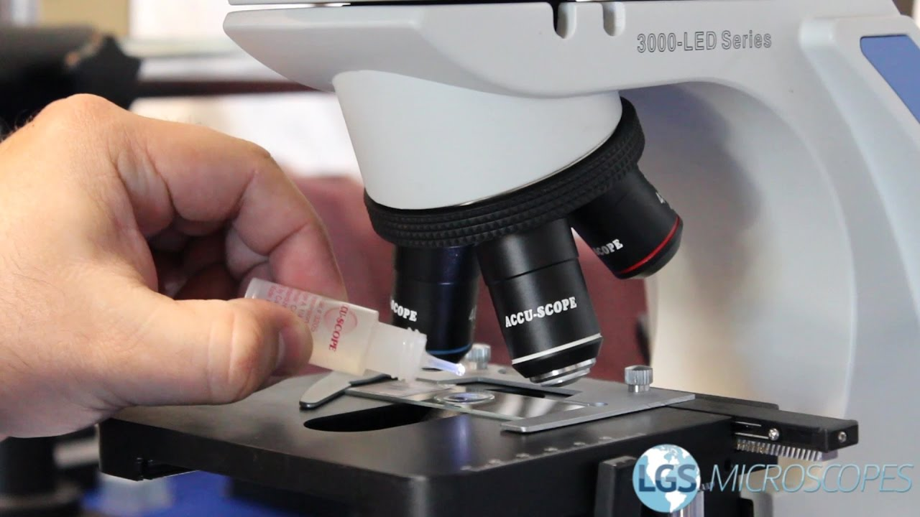
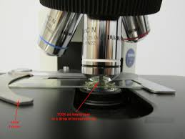
13- To use the oil-immersion objective lens (100x), rotate the nosepiece a way from the slide and place a drops of oil on the slide, then rotate back the nosepiece to use the oil immersion objective lens , do not change the position of the stage.
Using of the light microscope:-
University of Basrah – College of Dentistry– Basic Sciences
8

Slide 9
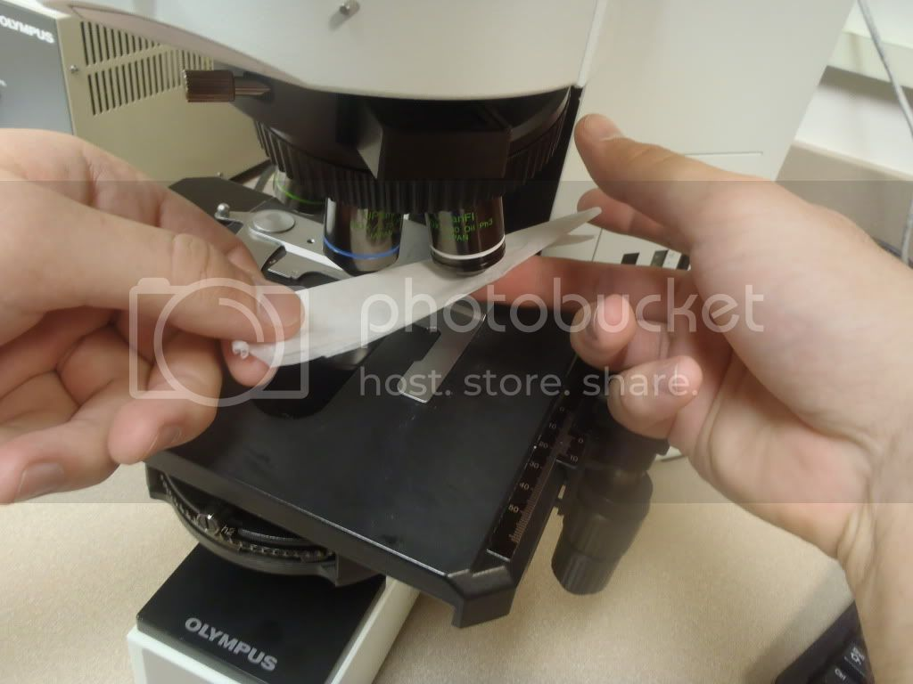
14- Refocus using the fine adjustment knobs only.
Using of the light microscope:-
15- After using the lens, wipe the oil from the objective lens with a piece of cleaning tissue contain clearing agents ( xylol or benzol).
University of Basrah – College of Dentistry– Basic Sciences
9

Slide 10
16- Return back the nosepiece to the scanner objective lens (4x)
Using of the light microscope:-
17- Reduce the light intensity and switch off the light. 18- Cover the microscope and put it in a safe place.
University of Basrah – College of Dentistry– Basic Sciences
10

Slide 11
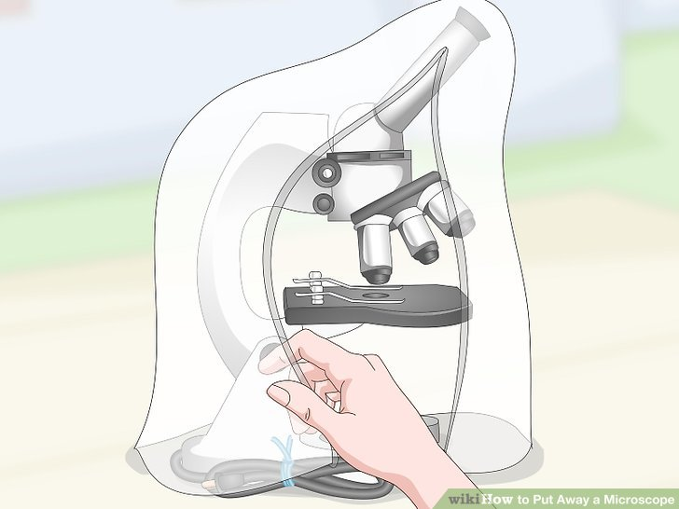
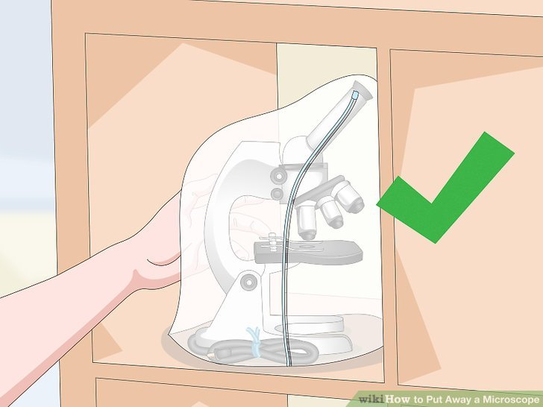
Using of the light microscope:-
Note:- 1. Scanning --> use coarse and fine knob 3. High power --> use fine knob only 2. Low power --> use coarse and fine knob 4. Oil immersion – use fine knob only
University of Basrah – College of Dentistry– Basic Sciences
11

